Slide 1
Microprocessor System Design IO Applications
Omid Fatemi
(omid@fatemi.net)

Slide 2
Outline
LCD
Stepper motors
Variable Reluctance
Permanent Magnet

Slide 3
New LCDs Interfacing
Lower prices
Display numbers, characters, graphics
Integrated refreshing controller
Ease of programming

Slide 4
LCD internal components
DDRAM (Data Display RAM)
CGRAM (Character Generator RAM)
Cursor (Address Counter)
Data Register
Command Register
CGRAM
40H
41H
42H
7EH
7FH
Data Register
...
Command Register
DDRAM
Cursor
80H
81H
82H
FEH
FFH
...

Slide 5
DDRAM (Data Display RAM)
DDRAM (Data Display RAM)
It is a 128x8 RAM (128 bytes of RAM)
Contains the data that should be displayed on the LCD.
If we write the ASCII code of a character into the RAM the character will be displayed on the LCD.
CGRAM (Character Generator RAM)
It is a 64x8 RAM (64 bytes of RAM).
The fonts of characters 00H to 07H are stored in the RAM.
We can change the fonts of the 8 characters by writing into the RAM.
Cursor (Address Counter)
Cursor is a register which points to a location of DDRAM or CGRAM.

Slide 6
DDRAM (Data Display RAM)
Data Register
It is an 8 bit register.
When we write a byte of data into the data register, the data will be written where the cursor points to.
For example, if we write a byte of data into the data register while the cursor points to location 80H of DDRAM, the contents of location 80H will be changed to the data, we have written into the data register.
Command Register
We can command the LCD by writing into the command register.
For example, we can ask the LCD, to set cursor location, or clean the screen, by writing into the command Register.

Slide 7
Writing to Data Register (Example)
CGRAM
40H
41H
42H
7EH
7FH
Data Register
...
50H
Command Register
DDRAM
Cursor
80H
81H
82H
FEH
FFH
...
P

Slide 8
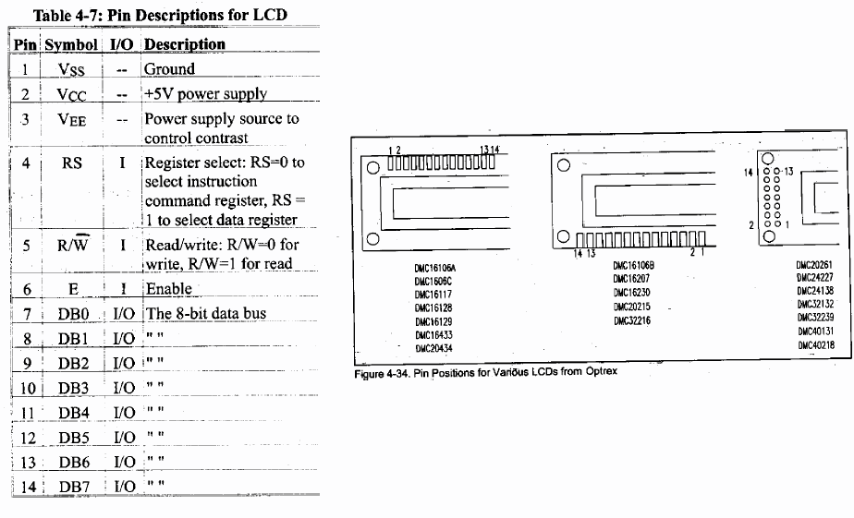
Pin Description

Slide 9
LCD pins
D7
D6
D5
D4
D3
D2
D1
D0
E
RW
V_{EE}
V_{CC}
RS
V_{SS}
In this section, you learn the functionalities of the LCD pins.

Slide 10
LCD pins
D7
D6
D5
D4
D3
D2
D1
D0
E
RW
V_{EE}
V_{CC}
RS
V_{SS}
+
-
+5
V_{SS} and V_{CC}: These pins provide the energy to the LCD. We must connect them to +5^{V}.

Slide 11
LCD pins
Hello world !
D7
D6
D5
D4
D3
D2
D1
D0
E
RW
V_{EE}
V_{CC}
RS
V_{SS}
+
-
+5
V_{EE}: We control the contrast of the LCD by giving a voltage between 0^{V} and +5^{V} to the pin.

Slide 12
LCD pins
D7
D6
D5
D4
D3
D2
D1
D0
E
RW
V_{EE}
V_{CC}
RS
V_{SS}
D0 to D7: LCD sends and receives data, through the 8 pins.

Slide 13
LCD pins
D7
D6
D5
D4
D3
D2
D1
D0
E
RW
V_{EE}
V_{CC}
RS
V_{SS}
R/W (Read/Write):
When we want to send (write) data to the LCD, we make the pin, low.
When we want to receive (read) data from the LCD, we set the pin to high.

Slide 14
LCD pins
D7
D6
D5
D4
D3
D2
D1
D0
E
RW
V_{EE}
V_{CC}
RS
V_{SS}
E (Enable): We activate the pin when we want to send or receive data from the LCD.
When we want to send data to the LCD, we make the RW pin, low; and supply the data to data pins (D0 to D7); and then apply a high to low pulse to the Enable pin.
When we want to receive data from the LCD, we make the RW pin, high; and then apply a low to high pulse to the Enable pin. LCD supplies data to the data pins (D0 to D7).
E
E

Slide 15
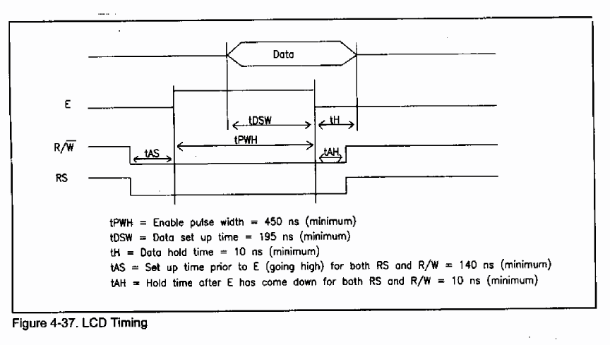
LCD Timing

Slide 16
LCD pins
D7
D6
D5
D4
D3
D2
D1
D0
E
RW
V_{EE}
V_{CC}
RS
V_{SS}
RS (Register select): There are two registers with names of command register and data register in the LCD.
If RS = 1, whenever we send data to the LCD, the data will be located in the data register.
If RS = 0, whenever we send data to the LCD, the data will be located in the command register
Data Register
RS
0
1
Command Register

Slide 17
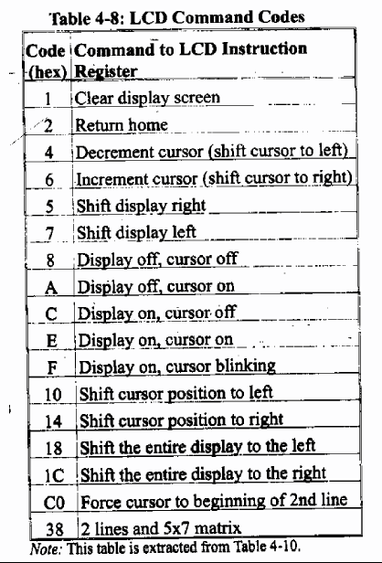
Command Codes

Slide 18
LCD commands
We mentioned earlier that we can order the LCD by sending command codes to the command register.
Some of the command codes are listed in the following table.
Code (Hex) | Instruction | Code (Hex) | Instruction
1 | Clear display screen | 2 | Return home
10 | Shift cursor position to left | 14 | Shift cursor position to right
18 | Shift display left | 1C | Shift display right
4 | After displaying a character on the LCD, shift cursor to left | 6 | After displaying a character on the LCD, shift cursor to right
80-FF | Set cursor position | 40-7F | Set CG RAM address
8 | Display off, cursor off | A | Display off, cursor on
C | Display on, cursor off | E | Display on, cursor on
F | Display on, cursor blinking | 38 | Initializing to 2 lines & 5x7 font

Slide 19
Display and Cursor
Display on cursor blinking (0FH)
Display on cursor on (0EH)
Hello world !
Hello world !
Display on cursor off (0CH)
Display off cursor off (0AH)
Hello world !

Slide 20
Clear Display Screen
If we write 01H into the command register, LCD clears the display, and sets the cursor address to 0.

Slide 21
Return home
If we write 02H into the command register, LCD sets the cursor address to 0. It also returns display to original position if being shifted.

Slide 22
Set cursor position (Set DDRAM address)
We mentioned earlier that each location of the DDRAM, retains the character that should be displayed in a location of LCD.
The following figures, represent that if you want to display a character in each of the rooms of the LCD, you should write into which location of the DDRAM. (The numbers are in hex.)
To move the cursor to any location of the DDRAM, write the address of that location into the command register.
1 2 3 … 18 19 20
Line 1
80 | 81 | 82 | … | 91 | 92 | 93
1 2 3 … 18 19 20
20x1 LCD
Line 1
Line 2
Line 3
Line 4
80 | 81 | 82 | … | 91 | 92 | 93
C0 | C1 | C2 | … | D1 | D2 | D3
94 | 95 | 96 | … | A5 | A6 | A7
D4 | D5 | D6 | … | E5 | E6 | E7
1 2 3 … 18 19 20
Line 1
Line 2
80 | 81 | 82 | … | 91 | 92 | 93
C0 | C1 | C2 | … | D1 | D2 | D3
20x4 LCD
20x2 LCD
1 2 3 … 38 39 40
1 2 3 … 14 15 16
Line 1
Line 2
80 | 81 | 82 | … | A5 | A6 | A7
C0 | C1 | C2 | … | E5 | E6 | E7
Line 1
Line 2
80 | 81 | 82 | … | 8D | 8E | 8F
C0 | C1 | C2 | … | CD | CE | CF
40x2 LCD
16x2 LCD

Slide 23
Set cursor position (example)
We want to display a character in line 4 column 1 of a 20x4 LCD. What should we write to the command register to move the cursor to?
Solution:
We should move cursor to address D4H of the DDRAM. So, we should write D4H, into the command register.
1 2 3 … 18 19 20
Line 1
Line 2
Line 3
Line 4
80 | 81 | 82 | … | 91 | 92 | 93
C0 | C1 | C2 | … | D1 | D2 | D3
94 | 95 | 96 | … | A5 | A6 | A7
D4 | D5 | D6 | … | E5 | E6 | E7

Slide 24
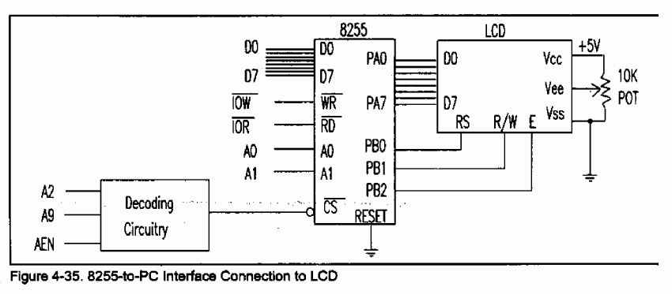
Example

Slide 25
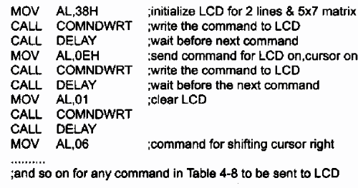
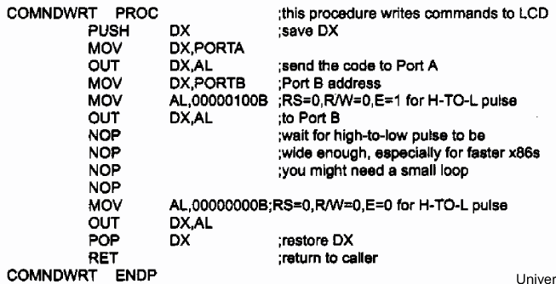
Programming LCD - Example
Notes:
Note high-to-low pulse on E

Slide 26
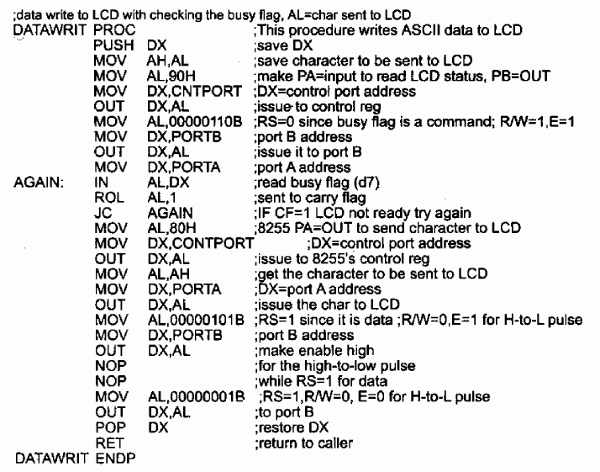
Sending Data

Slide 27
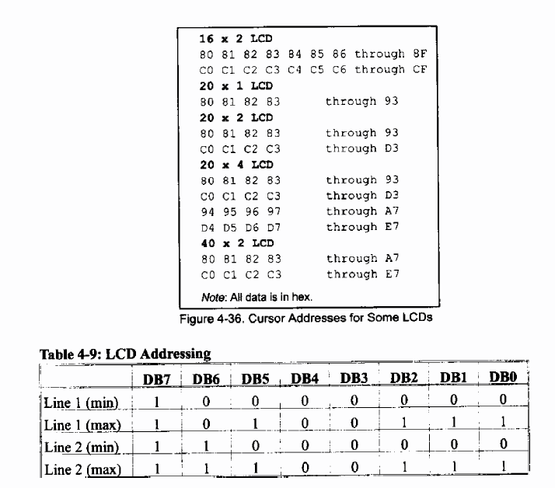
LCD Addressing

Slide 28
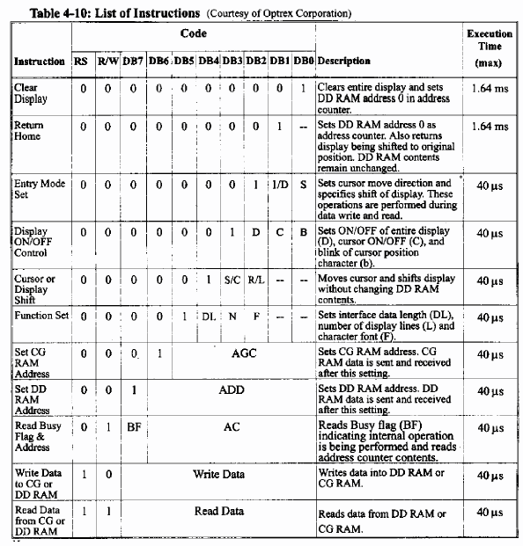
LCD Instructions
Notes:
DD RAM: Display Data RAM
CG RAM: Character Generator

Slide 29
Decrease and increase Cursor
If you write a byte of data into the data register, the data will be written where the cursor points to, and cursor will be incremented, by default.
If you want to make the LCD, to decrement the cursor, you should write 4H into the command register.
If you want to make the LCD, to reactivate the default (shift cursor to right) you should write 6H into the command register.
Hello
Hello
Increment cursor
Decrement cursor

Slide 30
LCD Programming
Initialization
We must initialize the LCD before we use it.
To initialize an LCD, for 5×7 matrix and 8-bit operation, 0x38, 0x0E, and 0x01 are send to the command register.
Sending commands to the LCD
Make pins RS and R/W = 0
Put the command number on the data pins (D0–D7)
Send a high-to-low pulse to the E pin to enable the internal latch of the LCD (wait about 100us after each command)
Sending data to the LCD
make pins RS = 1 and R/W = 0.
put the data on the data pins (D0–D7)
send a high-to-low pulse to the E pin (wait about 100us)
5x10 Font

Slide 31
An example
D7
D6
D5
D4
D3
D2
D1
D0
E
RW
V_{EE}
V_{CC}
RS
V_{SS}
Write a program that displays ‘H’ on the LCD, where the cursor is located.
PB.0 PB.1 PB.2 PB.3 PB.4 PB.5 PB.6 PB.7 RST VCC GND XTal2 XTal1 PD.0 PD.1 PD.2 PD.3 PD.4 PD.5 PD.6
PA.0 PA.1 PA.2 PA.3 PA.4 PA.5 PA.6 PA.7 AREF GND AVCCPC.7 PC.6 PC.5 PC.4 PC.3 PC.2 PC.1 PC.0 PD.7
AVR
Solution:
PORTA |= (1<<2); // (RS = 1) as we want to write to the data register
PORTA&= (1<<1); // (RW = 0) as we want to send data to the LCD.
PORTB = ‘H’; // as we want to send ‘H’ to the LCD.
//To make a High to low pulse on the Enable pin :
PORTA |= 1;
DELAY_ms (1);
PORTA.0 &= ~1;

Slide 32
LCD Programming in 4-bit mode
To save pins of the AVR, we can use 4-bit operating mode.
The initialization of 4-bit mode is somehow different:
In 4-bit mode, we initialize the LCD with the series 33, 32, and 28 in hex.
This represents nibbles 3, 3, 3, and 2, which tells the LCD to go into 4-bit mode. The value $28 initializes the display for 5 × 7 matrix and 4-bit operation
Sending commands and data to the LCD
Sending data and commands to the LCD is like the 8-bit mode but we should only use D4 – D7
First we should send the high nibble to D4-D7, then, to send the low nibble, swap the low nibble with the high nibble, and send it to D4-D7

Slide 33
Changing fonts (Changing CGRAM)
D7 D6 D5 D4 D3 D2 D1 D0
0 | 0 | 0 | 1 | 1 | 1 | 1 | 0
0 | 0 | 0 | 1 | 0 | 0 | 0 | 1
0 | 0 | 0 | 1 | 0 | 0 | 0 | 1
0 | 0 | 0 | 1 | 1 | 1 | 1 | 0
0 | 0 | 0 | 1 | 0 | 1 | 0 | 0
0 | 0 | 0 | 1 | 0 | 0 | 1 | 0
0 | 0 | 0 | 1 | 0 | 0 | 0 | 1
0 | 0 | 0 | 0 | 0 | 0 | 0 | 0
0 | 0 | 0 | 1 | 0 | 0 | 0 | 1
0 | 0 | 0 | 0 | 1 | 0 | 1 | 0
0 | 0 | 0 | 1 | 1 | 1 | 1 | 1
0 | 0 | 0 | 0 | 0 | 1 | 0 | 0
0 | 0 | 0 | 1 | 1 | 1 | 1 | 1
0 | 0 | 0 | 0 | 0 | 1 | 0 | 0
0 | 0 | 0 | 0 | 0 | 1 | 0 | 0
0 | 0 | 0 | 0 | 0 | 0 | 0 | 0
40
41
42
43
44
45
46
47
48
49
4A
4B
4C
4D
4E
4F
:
:
Each character LCD has a CGRAM (Character generator RAM).
It stores the fonts of the first 8 characters (character 0H to character 7H).
Each byte of the CGRAM stores a row of a font.
The fonts are stored respectively, in the CGRAM.
For example, if you change the content of first byte of the CGRAM (whose address is 40H), you have changed the highest row of character 0H.
Attention: in an LCD with 5x7 font, each font has actually 8 rows. The 8th row is put aside for the cursor. You would better not set the bits of the 8th row.
Character 0
Character 1
CGRAM (Its first 16 bytes)

Slide 34
Changing fonts
To change a row of a font, you should follow the following direction:
Set the cursor position to point to the location of the CGRAM that you want to change.
Change the font of the selected row, by writing into data register.
Attention: LCD has only one cursor. When you want to change the CGRAM you make it point to CGRAM and when you want to display something on the screen you make it point to a location of DDRAM. So, when you finished changing the fonts don’t forget to set the cursor position, so that, it points to DDRAM.

Slide 35
Setting CGRAM address
To make the cursor point to any location of CGRAM, or DDRAM, simply write the address of the location into the command register.

Slide 36
Setting CGRAM address (Example)
We want to change the font of the 4th row of character 01H. What should we write to the command register to make the cursor point to the relevant address.
D7 D6 D5 D4 D3 D2 D1 D0
0 | 0 | 0 | 1 | 1 | 1 | 1 | 0
0 | 0 | 0 | 1 | 0 | 0 | 0 | 1
0 | 0 | 0 | 1 | 0 | 0 | 0 | 1
0 | 0 | 0 | 1 | 1 | 1 | 1 | 0
0 | 0 | 0 | 1 | 0 | 1 | 0 | 0
0 | 0 | 0 | 1 | 0 | 0 | 1 | 0
0 | 0 | 0 | 1 | 0 | 0 | 0 | 1
0 | 0 | 0 | 0 | 0 | 0 | 0 | 0
0 | 0 | 0 | 1 | 0 | 0 | 0 | 1
0 | 0 | 0 | 0 | 1 | 0 | 1 | 0
0 | 0 | 0 | 1 | 1 | 1 | 1 | 1
0 | 0 | 0 | 0 | 0 | 1 | 0 | 0
0 | 0 | 0 | 1 | 1 | 1 | 1 | 1
0 | 0 | 0 | 0 | 0 | 1 | 0 | 0
0 | 0 | 0 | 0 | 0 | 1 | 0 | 0
0 | 0 | 0 | 0 | 0 | 0 | 0 | 0
40
41
42
43
44
45
46
47
Solution:
As you can see in the figure, the address of the 4th row of character 01H is 4BH. So, we should write 4BH into the command register.
Character 0
48
49
4A
4B
4C
4D
4E
4F
:
:
Character 1
CGRAM (Its first 16 bytes)

Slide 37
additional references
You can find useful datasheets and user manuals about different LCDs in http://www.optrex.com/

Slide 38
Stepper Motors

Slide 39
Stepper Motors
more accurately controlled than a normal motor allowing fractional turns or n revolutions to be easily done
low speed, and lower torque than a comparable D.C. motor
useful for precise positioning for robotics
Servomotors require a position feedback signal for control

Slide 40
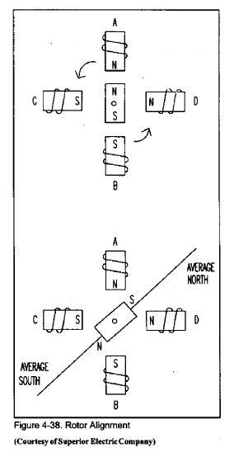
Stepper Motor Diagram

Slide 41
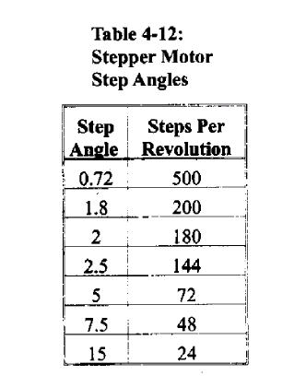
Stepper Motor Step Angles

Slide 42
Terminology
Steps per second, RPM
SPS = (RPM * SPR) /60
Number of teeth
4-step, wave drive 4-step, 8-step
Motor speed (SPS)
Holding torque

Slide 43
Stepper Motor Types
Variable Reluctance
Permanent Magnet
Notes:
http://www.cs.uiowa.edu/~jones/step/types.html
reluctance magnet becomes temporarily magnetized when placed in a magnetic field
(http://www.theproductfinder.com/motors/linste.htm)

Slide 44
Permanent Magnet

Slide 45
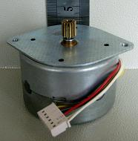
Stepper motor
Stepper motor is a motor, whose rotation angle is proportional to its input pulse.
Rotor
A
tooth
N
COM
S
S
N
N
B
S
Stator
C
COM
D

Slide 46
N
B
S
N
+5^{V}
S
S
N
S
N
S
N
N
D
S
N
S
C
+5^{V}
A

Slide 47
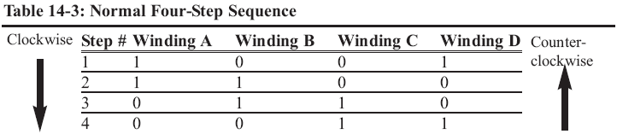
Stepping
N
B
S
N
+5^{V}
S
S
N
S
N
S
N
N
D
S
N
S
C
+5^{V}
A

Slide 48
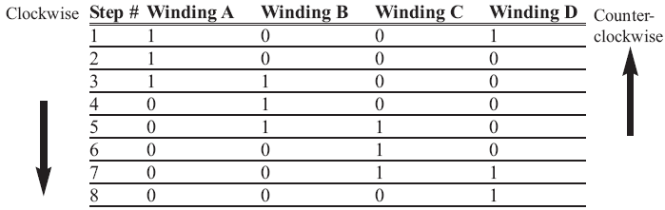
Half stepping
N
B
S
N
+5^{V}
S
S
N
S
N
S
N
N
D
S
N
S
C
+5^{V}
A

Slide 49
Calculations
N
B
S
N
+5^{V}
N
S
N
S
D
S
N
S
Step angle =
90
Num of teeth
A
+5^{V}
C
Steps per revolution =
360
= 4 * Num of teeth
Step angle
Steps per second =
RPM * Steps per revolution
60

Slide 50
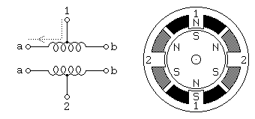
Unipolar Motors

Slide 51
Unipolar Motors
To rotate we excite the 2 windings in sequence
W1a - 1000100010001000100010001
W1b - 0010001000100010001000100
W2a - 0100010001000100010001000
W2b - 0001000100010001000100010
This gives two full revolutions

Slide 52
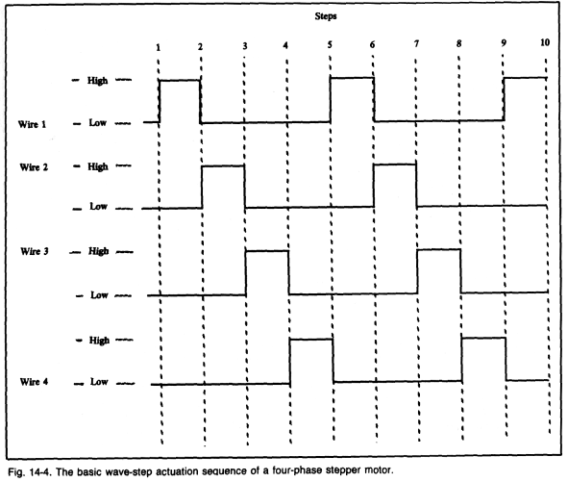
Basic Actuation Wave Forms

Slide 53
Unipolar Motors
To rotate we excite the 2 windings in sequence
W1a - 1100110011001100110011001
W1b - 0011001100110011001100110
W2a - 0110011001100110011001100
W2b - 1001100110011001100110011
This gives two full revolutions at 1.4 times greater torque but twice the power
Notes:
When two windings are excited then the magnetic field has more power and since they are 90 degree then the total would be 1.4 times
But the power (the current) is doubled

Slide 54
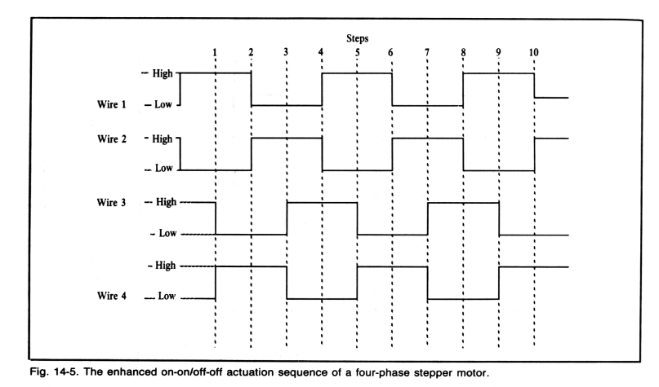
Enhanced Waveforms
better torque
more precise control

Slide 55
Unipolar Motors
The two sequences are not the same, so by combining the two you can produce half stepping
W1a - 11000001110000011100000111
W1b - 00011100000111000001110000
W2a - 01110000011100000111000001
W2b - 00000111000001110000011100

Slide 56
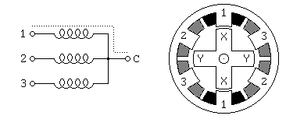
Variable Reluctance Motors

Slide 57
Variable Reluctance Motors
This is usually a four wire motor – the common wire goes to the +ve supply and the windings are stepped through
Our example is a 30º motor
The rotor has 4 poles and the stator has 6 poles
Example
Notes:
Rotor is magnet

Slide 58
Variable Reluctance Motors
To rotate we excite the 3 windings in sequence
W1 - 1001001001001001001001001
W2 - 0100100100100100100100100
W3 - 0010010010010010010010010
This gives two full revolutions

Slide 59
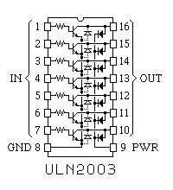
Motor Control Circuits
For low current options the ULN200x family of Darlington Arrays will drive the windings direct.

Slide 60
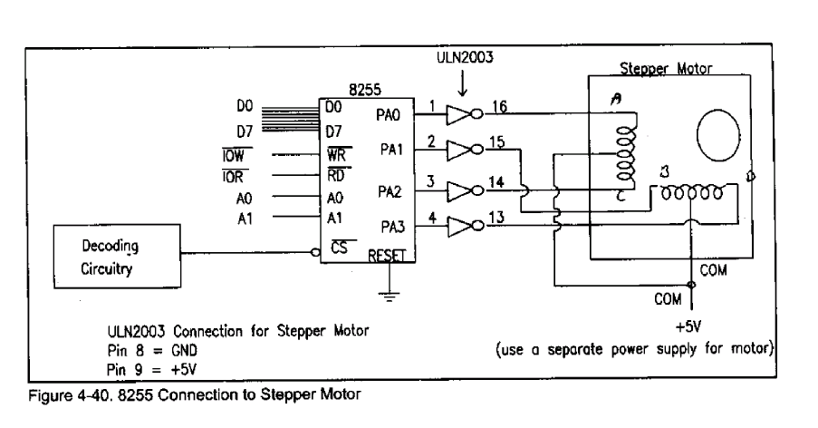
Interfacing to Stepper Motors

Slide 61
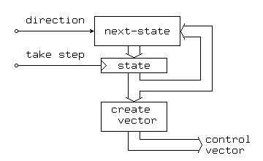
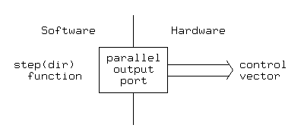
Vector Generation
Hardware solutions
Logic design
State machine
Software solutions
Microprocessor and output ports
timing

Slide 62
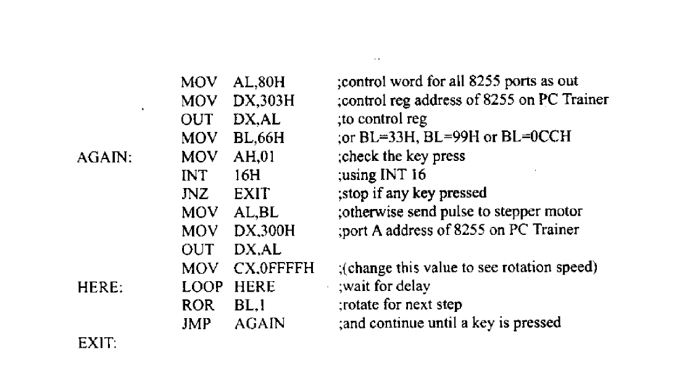
Example

Slide 63
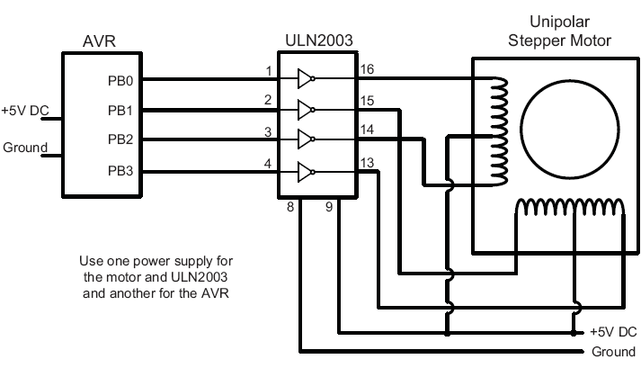
AVR and a Stepper motor

